Slide 1
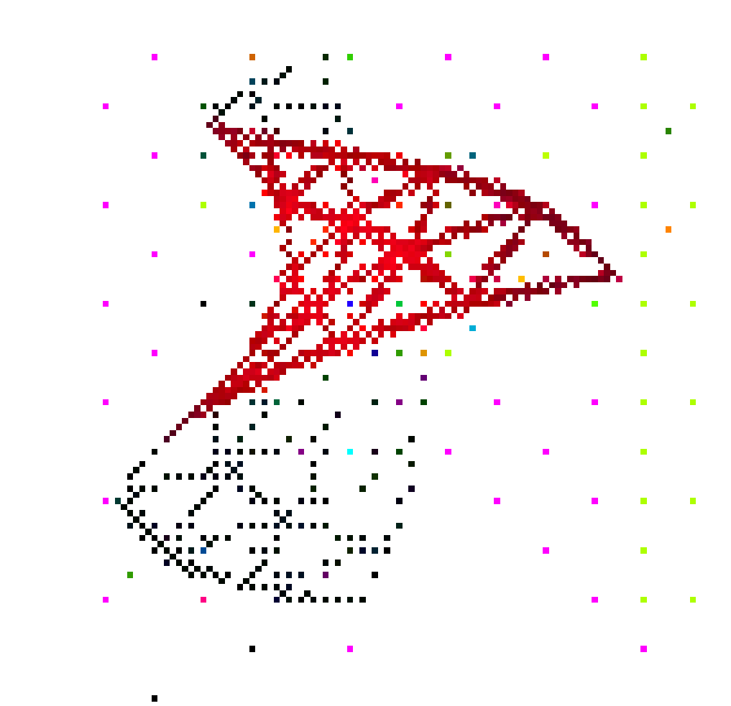
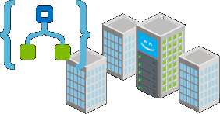
Data As A Service Server-less applications, big data and NoSQL DB
Processing and ML
No SQL DB
Provide an infrastructure aligned with the vision of cooperating knowledge building and sharing among teams
Provide online services for images and metadata, adopting a DaaS approach
Experiment with ML
Include feedback of medicine physicians
Other storage
Logic Apps
API app
Web app
API Management
1
2
3
Custom on-premises applications
Notes:
Furthermore, the allocated size and the partitions created for the uploaded data are shown in the two diagrams
Although relational databases are invaluable in specific cases, when it comes to specific areas of the energy domain, it is better for the data management problem to consider other alternatives as well. In order to handle efficiently the required big numbers in volume (millions off end-points), velocity (millions of measurements per minute) and variety (hundreds to thousands of different end-point types, we do need structured data but not in the classic relational way. For this, IT research has been oriented to technologies collectively denoted as NoSQL DB in order to stress their independence from the strict tabular data modeling approach. Starting from simply separating the data tables to multiple ones spread into different logical or physical nodes (i.e. database servers) up to emphasizing data structures like key-value, graph, or documents that are better suited to represent complex inter-object relationships.

Slide 2
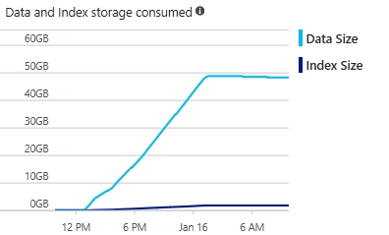
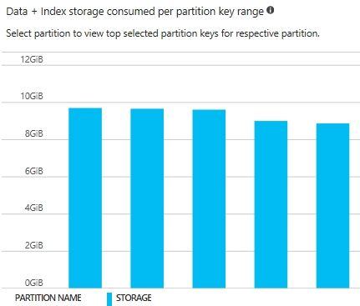
Server less applications, big data and NoSQL data base performance
Notes:
Furthermore, the allocated size and the partitions created for the uploaded data are shown in the two diagrams
Although relational databases are invaluable in specific cases, when it comes to specific areas of the energy domain, it is better for the data management problem to consider other alternatives as well. In order to handle efficiently the required big numbers in volume (millions off end-points), velocity (millions of measurements per minute) and variety (hundreds to thousands of different end-point types, we do need structured data but not in the classic relational way. For this, IT research has been oriented to technologies collectively denoted as NoSQL DB in order to stress their independence from the strict tabular data modeling approach. Starting from simply separating the data tables to multiple ones spread into different logical or physical nodes (i.e. database servers) up to emphasizing data structures like key-value, graph, or documents that are better suited to represent complex inter-object relationships.

Slide 3
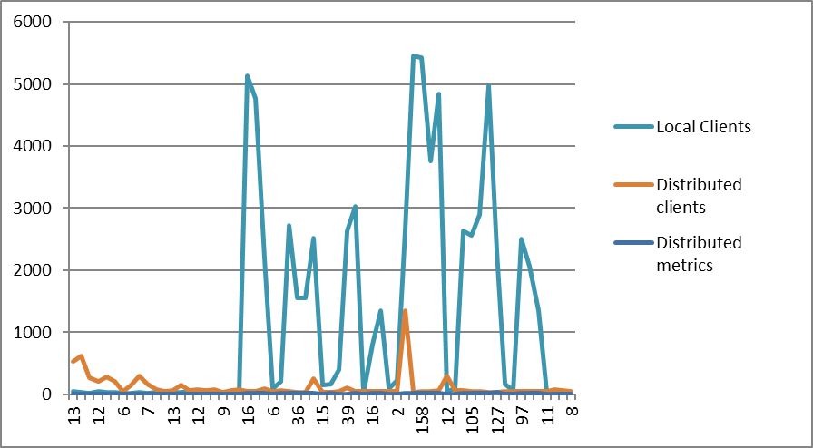
NoSQL DB performance – read operations of PET images metadata

Slide 4
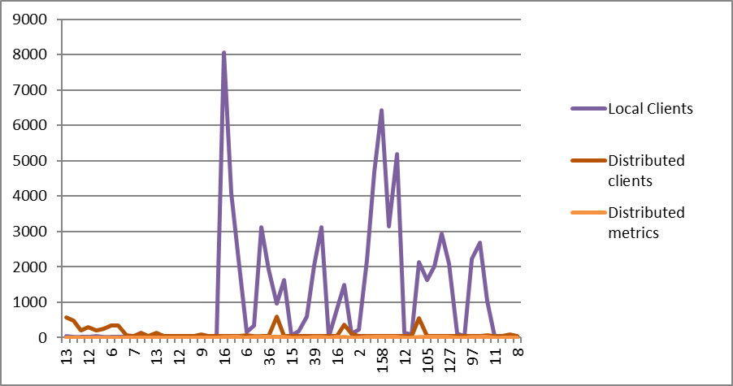
NoSQL DB performance – write operations of PET images metadata

Slide 5
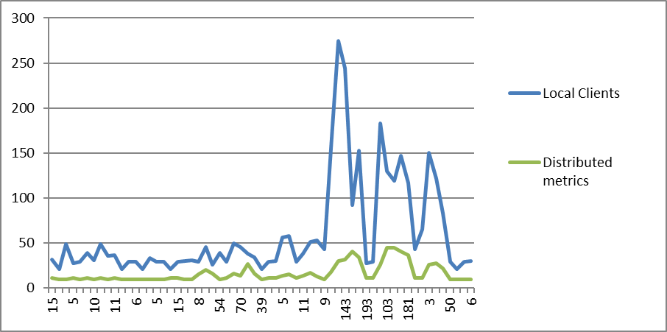
NoSQL DB performance – query operations of PET images metadata

